Slide 1
Machine Learning Project Ames Housing Price Prediction
Cheng Zhao

Slide 2
Contents
Exploratory Data Analysis & Linear Regression Assumptions
Training & Model Selection
Introduction
Data Cleaning & Feature Engineering
Results and Conclusions

Slide 3
Introduction
Project Description
Target Audience
Research Question
Kaggle competition to use Machine Learning techniques to predict housing prices in Ames, Iowa.
Take on the role of a pretend real estate database company looking to provide accurate housing price predictions for site visitors. Can also be used for house flippers.
Which ML model and with what parameters performs the best in terms of predicting housing prices in Ames, Iowa.
Disclaimer
I was working on this project during my break from the program so I approached it from the Kaggle competition perspective with half/half as train/test set. Was not aware of the project pitch or the complete dataset with geographical data.

Slide 4
Data Cleaning
Load in train and test set as dataframes with ID as index.
Training set shape is 1460 rows × 80 columns (with SalePrice).
Testing set shape is 1459 rows × 79 columns (without SalePrice).
Check for duplicate entries. No duplicates found.
Correct feature data types.
MSSubClass is the code for the type of dwelling and should be categorical, not be numerical.
Resolve/Impute NA’s.
Utilities: Impute with “AllPub” since it’s the most common by far.
GarageYrBlt: Impute with “YearBuilt” since they almost always coincide.
Exterior1st & Exterior2nd: Impute both with “VinylSd” since it’s the most common.
MasVnrType & MasVnrArea: For cases where both are NA, impute with None and 0. For one entry with area, impute type as “BrkFace” since it’s the most common.
Bsmt variables: Two entries with no basement but values are NA instead of 0, change to 0.
Functional: Impute with “Typ” since it’s the most common.
KitchenQual: Impute with “TA” since it’s the most common.
GarageCars & GarageArea: Replace with 0.

Slide 5
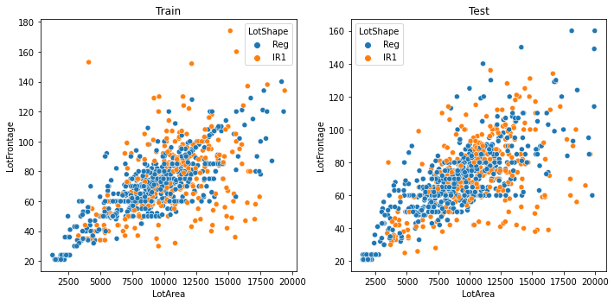
Data Cleaning - LotFrontage
LotFrontage had a very high number of NA’s (259 in training set and 227 in testing set).
Simply replacing NA’s with 0 seems to be a bad idea, especially since LotArea is not 0 and every LotConfig and LotShape has NA’s, including “FR2”, “FR3” and “Reg”.
Logically speaking, would expect LotFrontage to be relatively highly correlated to LotArea. Study scatter plot to see if this is indeed the case. Only look at units with LotArea <= 20000 to avoid outliers and only LotShapes of Reg and IR1 since most units are those two.
For LotShape = Reg, the relationship appears to be fairly linear. IR1 is much more random.
Will do regression on all LotShape = Reg entries and impute missing with predicted value. This will introduce multicollinearity issues but will deal with it later.

Slide 6
Feature Engineering
YearBuilt: The age of the house when sold makes more sense as a variable, so create variable which is AgeSold = YrSold - YearBuilt and remove YearBuilt.
YrSold: Convert to nominal categorical since the factor being evaluated now is really the economy and real estate market during the year.
MoSold: Same logic as YrSold and shouldn’t be considered an ordinal feature. Simplify MoSold to the quarter and convert to nominal categorical.
YearRemodAdd: Just convert to whether the house was remodelled or not.
GrLivArea & TotalBsmtSF: GrLivArea = 1stFlrSF + 2ndFlrSF + LowQualFinSF and TotalBsmtSF = BsmtFinSF1 + BsmtFinSF2 + BsmtUnfSF so they are both redundant information. Remove both features.
Bathrooms (Above ground and basement): To reduce some dimensionality, consider half bathrooms to be 0.5 bathrooms and add to number of full bathrooms.
TotRmsAbvGrd: Convert to number of non-bedroom or kitchen rooms. Create variable OtherRms = TotRmsAbvGrd - BedroomAbvGr - KitchenAbvGr and remove TotRmsAbvGrd.
Notes:
Perhaps could argue reduction in purchasing power reduces year to year due to inflation but cannot claim it's a certainty nor that the degree is consistent.

Slide 7
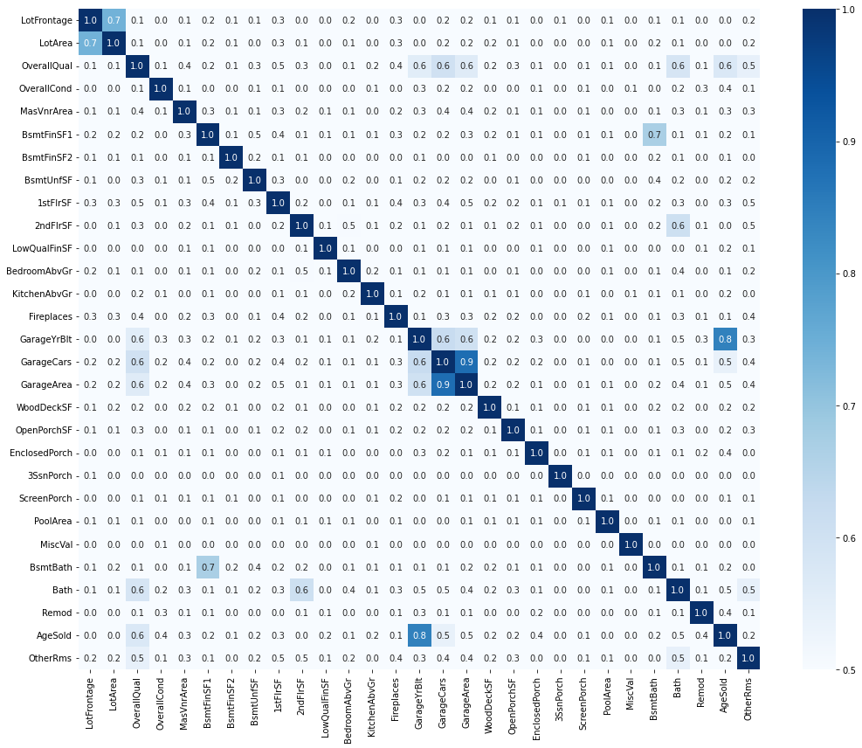
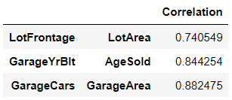
Data Exploration for Linear Regression Assumptions - Multicollinearity
Multicollinearity results in coefficients with higher standard errors and causes the model to become unstable. Therefore, need to check for and resolve multicollinearity issues between features.
Plot correlation matrix and see if some highly correlated features can/should be removed.
Feature pairs with correlation > 0.7

Slide 8
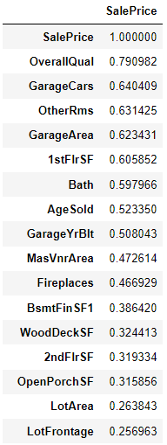
Data Exploration for Linear Regression Assumptions - Multicollinearity (Cont.)
Also make table showing correlation of each feature to SalePrice.
LotFrontage & LotArea: This is expected, especially given that LotFrontage NA's were imputed with linear regression with LotArea as the independent variable. Will remove LotFrontage due to many NAs as well as LotArea logically being more important with higher correlation to target variable.
GarageYrBlt & AgeSold: This is expected since for a vast majority of houses the year built will be the same. Will remove GarageYrBlt since AgeSold is logically more important with higher correlation to target variable.
GarageCars & GarageArea: This is expected since garage size in car capacity is directly indicative of the garage area. Will remove GarageArea since GarageCars has higher correlation to target variable.

Slide 9
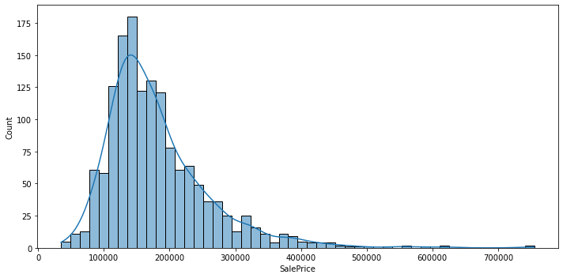
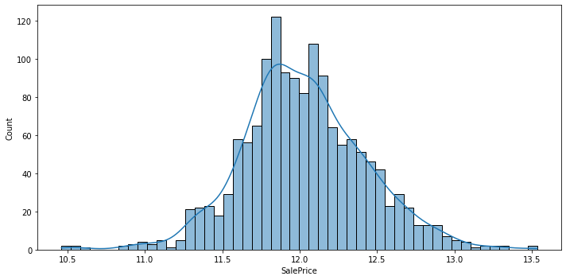
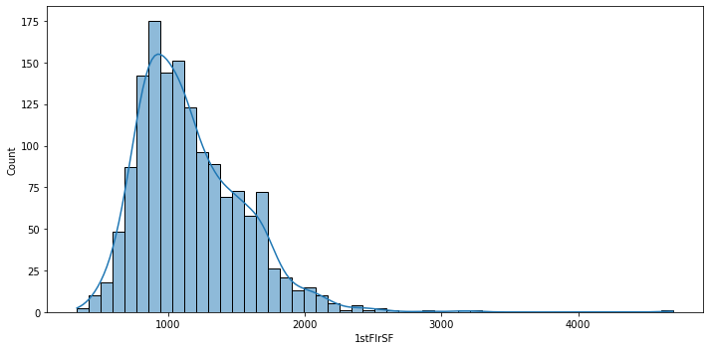
Data Exploration for Linear Regression Assumptions - Normality
The assumption that residuals are normally distributed can be violated due to presence of outliers as well as non-normally distributed variables.
The target SalePrice is skewed. Apply log-transformation to SalePrice.
Other features are also not necessarily normally distributed, such as 1stFlrSF below. However features are not what needs to be normally distributed, just the residuals should be. Therefore will run model first and check if assumption is met. If not, come back and apply log transformation to variables.
Before log-transformation
After log-transformation

Slide 10
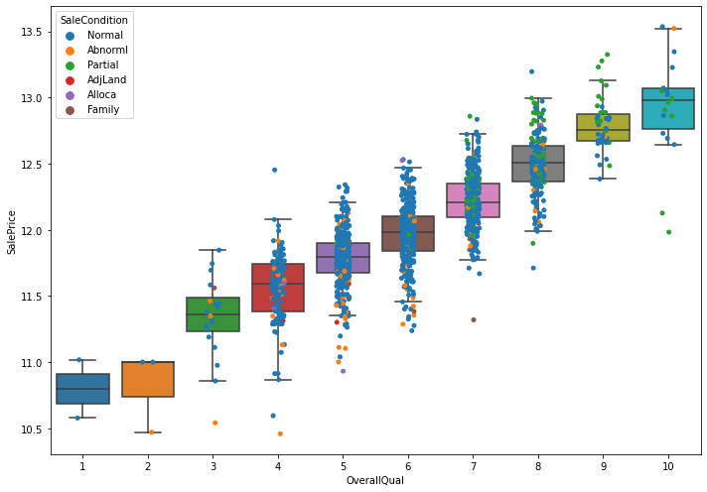
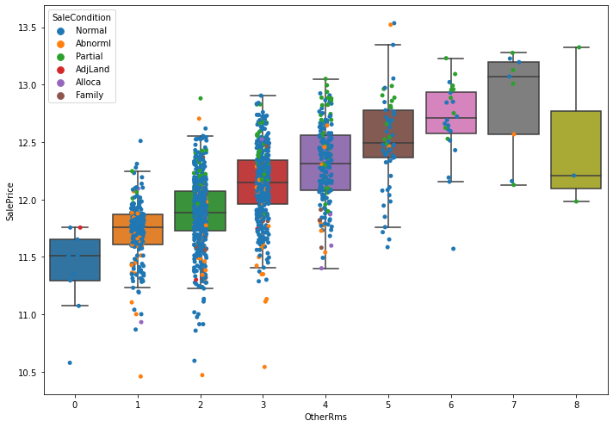
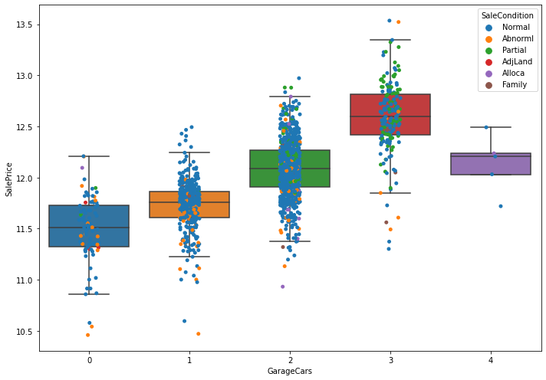
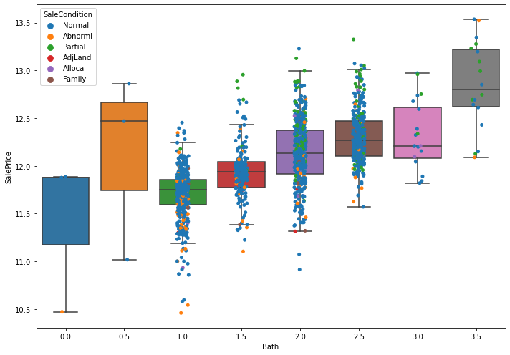
Data Exploration for Linear Regression Assumptions - Normality (Cont.)
Check for outliers with the top 5 features with highest correlation to sale price.
Have suspicion that some outliers may be based on SaleCondition being abnormal, so color points to show SaleCondition.
As shown, there are definitely some outliers.

Slide 11
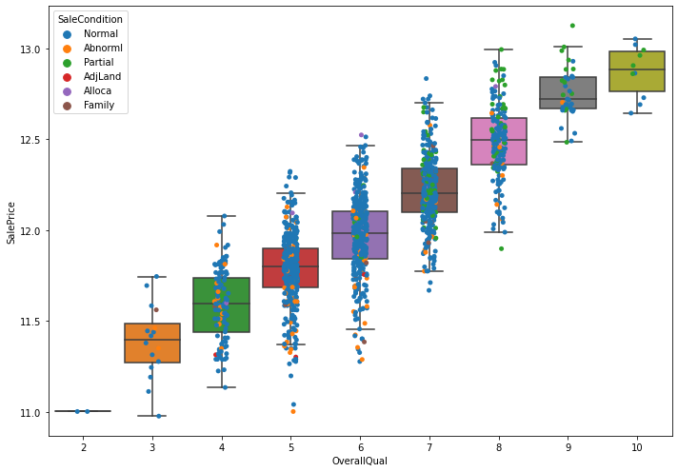
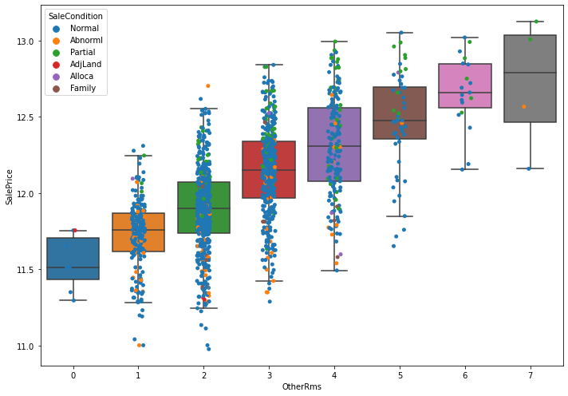
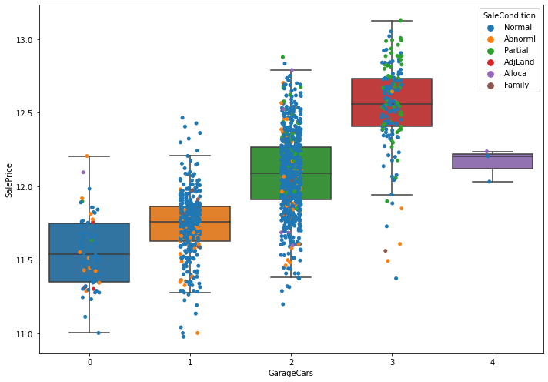
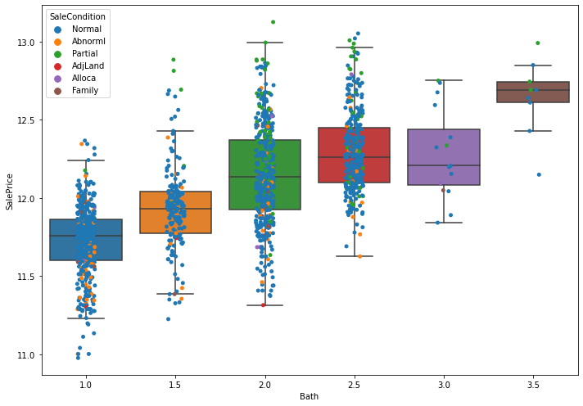
Data Exploration for Linear Regression Assumptions - Normality (Cont.)
Want to systematically remove outliers. For each of the 4 top ordinal features, remove data points below 0.5 percentile and above 99.5 percentile for each group.
Doing so can remove enough points such that certain feature values don't have any entries, such as OverallQual of 1. Can implement method where if group has less than a certain count then do not remove outliers but will just go with this method for now.
Number of entries reduced to 1401. Removed 59 data points.

Slide 12
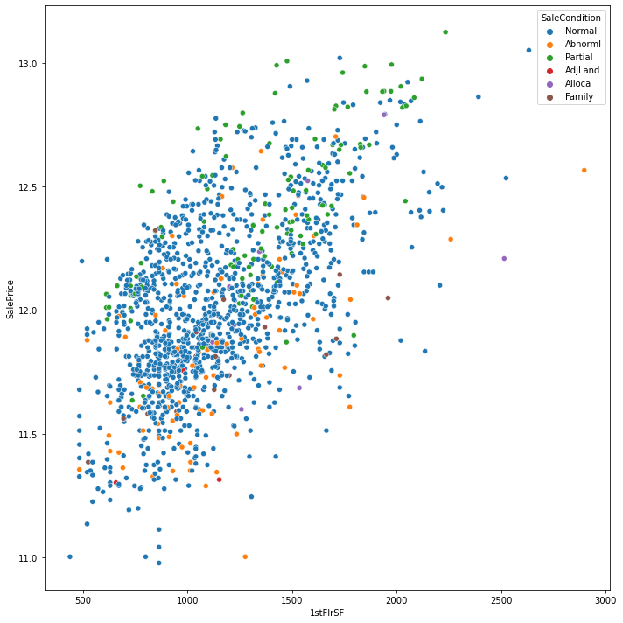
Data Exploration for Linear Regression Assumptions - Normality (Cont.)
Check 1stFlrSF.
No obvious outliers, will not remove any more.

Slide 13
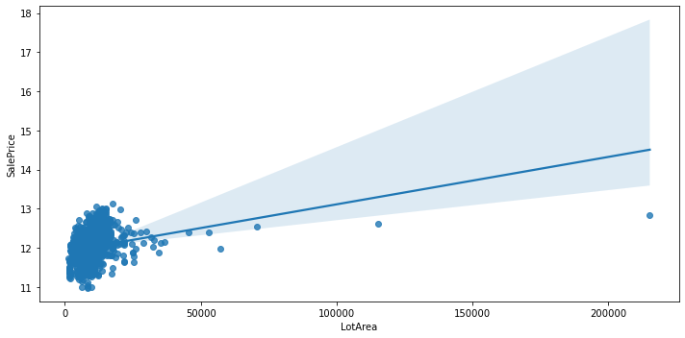
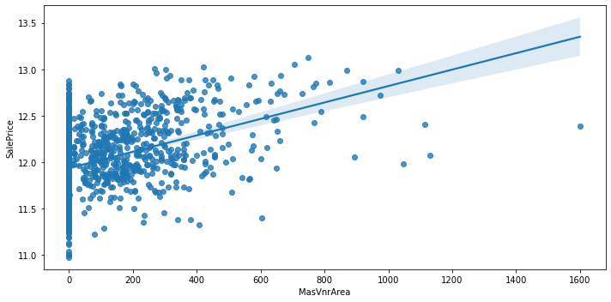
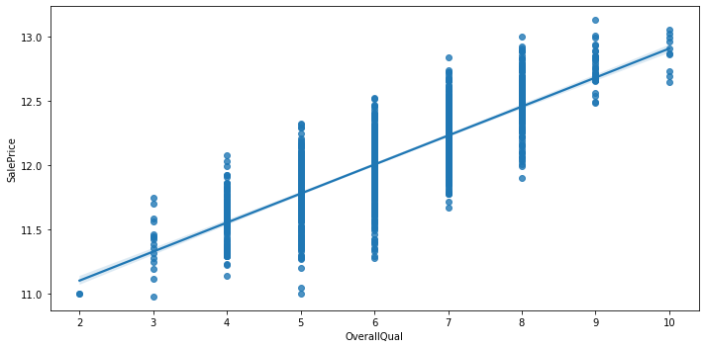
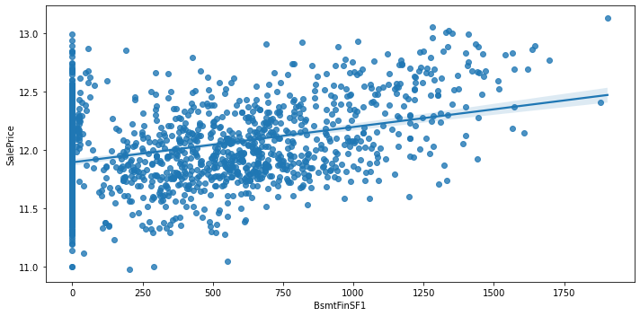
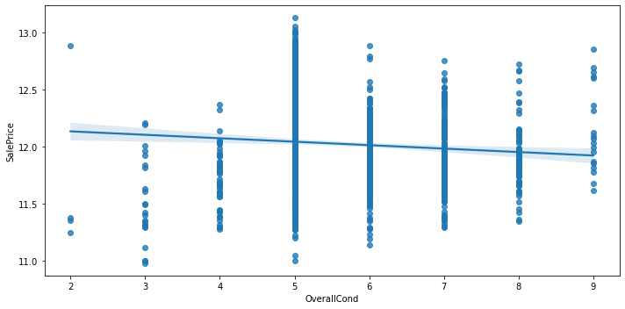
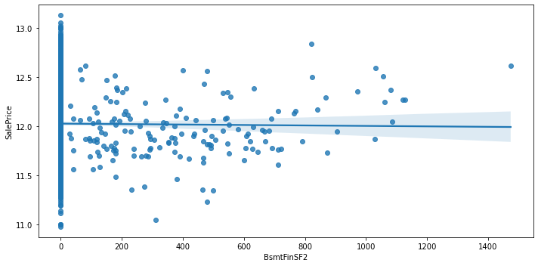
Data Exploration for Linear Regression Assumptions - Linearity
Too many features to deal with and do not have good way to systematically resolve non-linearity.
Just leave features as they are for now.

Slide 14
Encoding Categorical Features and Finalizing Data Sets
Use OrdinalEncoder on ordinal categorical features.
Use OneHotEncoder on nominal categorical features and always drop one column.
After OneHotEncoder, realized some features are in training set but not in test set and vice versa. Remove features that are not shared. End up with 198 features.
Tree-based models do not need OneHotEncoder. Create a separate set where nominal categorical features are also ordinally encoded. Will try both on for tree-based models and see which route produces better results.

Slide 15

Training Models
Set up K-Fold cross validation.
Use RMSE as error metric to compare model performance.

Slide 16
Training Models - Multiple Linear Regression and Regularized Linear Regression
MLR is simple fit.
Since regularized linear regression penalizes the coefficients equally, need to standardize/normalize the features. Also look to tune alpha value for each model. Ridge, Lasso and Elastic Net all use the pipeline below and goes through GridSearchCV.

Slide 17
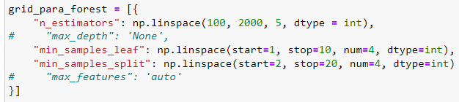
Training Models - Tree-based Models
Tree-based models do not require standardization/normalization, therefore no pipeline needed and just GridSearchCV.
Took approach where started off with coarse parameter tuning followed by another finer GridSearch. Example below.
Followed this approach for Random Forest and Gradient Boost and tried both the OneHotEncoded set and the all ordinally encoded set for each.
Random Forest had better score with all ordinally encoded set and Gradient Boost had better score with the OneHotEncoded set.

Slide 18
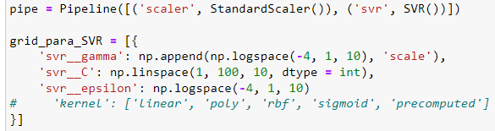
Training Models - SVM
Since all kernel methods are based on distance, features need to be standardized/normalized so the ones with greater numeric ranges do not dominate. Therefore, similar to regularized linear regression, the pipeline below is used.

Slide 19
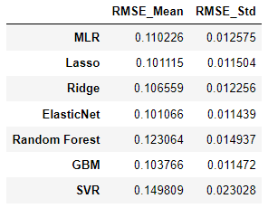
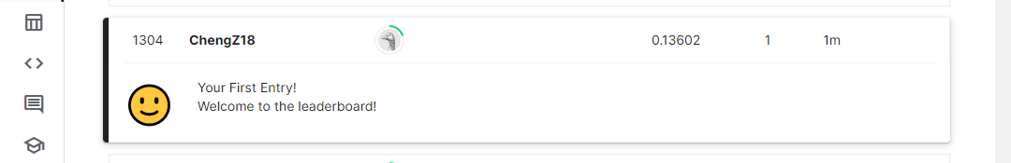
Model Comparison and Competition Submission
As shown in table on the left, Elastic Net had the lowest RMSE out of all tested models.
The best alpha value from GridSearchCV was ~0.0038. Use alpha value and fit Elastic Net model.
Make sure to transform the test set using the same StandardScaler fitted to the training set.
Predict test set.

Slide 20
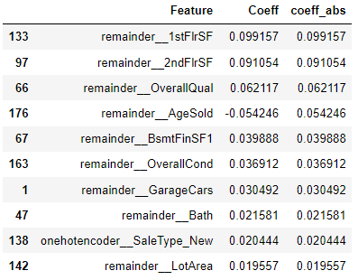
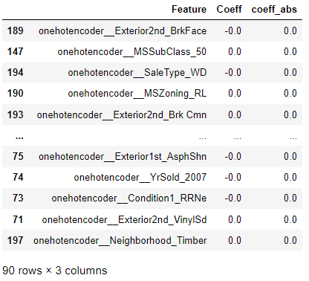
Further Exploration
Now that in my case Elastic Net was found to be the best model, can study the coefficients to see which features impact SalePrice the most. Since the features have been standardized, can directly compare coefficient magnitude.
It can be seen that the surface area is the biggest factor contributing to the price, followed by the overall quality and age of the house. The top ten highest coefficients all logically make sense to be big contributors.
Also check how many coefficients went to 0 with Elastic Net. 90 features out of 198 became 0.

Slide 21
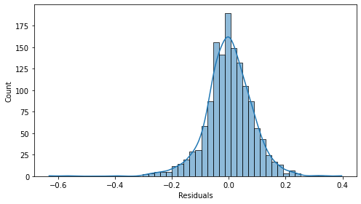
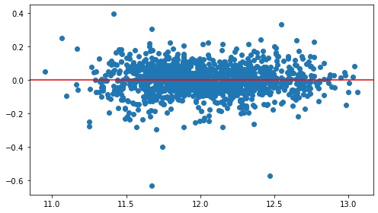
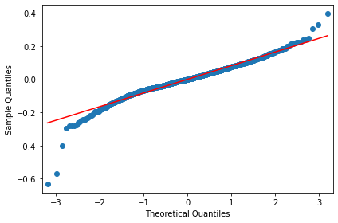
Revisit Linear Regression Assumptions
Just fit the MLR portion of the Elastic Net and check that linear regression assumptions are satisfied.
Normality
Homoscedasticity

Slide 22
Future Work
Make use of the geographical data and try to factor in the effect of neighborhood.
Attempt the descriptive modeling approach and try to figure out the reason for the discount on larger homes in terms of $/ft² as well as the various data analysis ideas in the project proposal.
Try transforming features to establish actual linear relationships.
Try stacking models.

Slide 23
THANKS!

